Slide 1
Classification of News into Real and Fake News
Group 6: Dhairya Amin, Parth Shah, Smit Dar

Slide 2
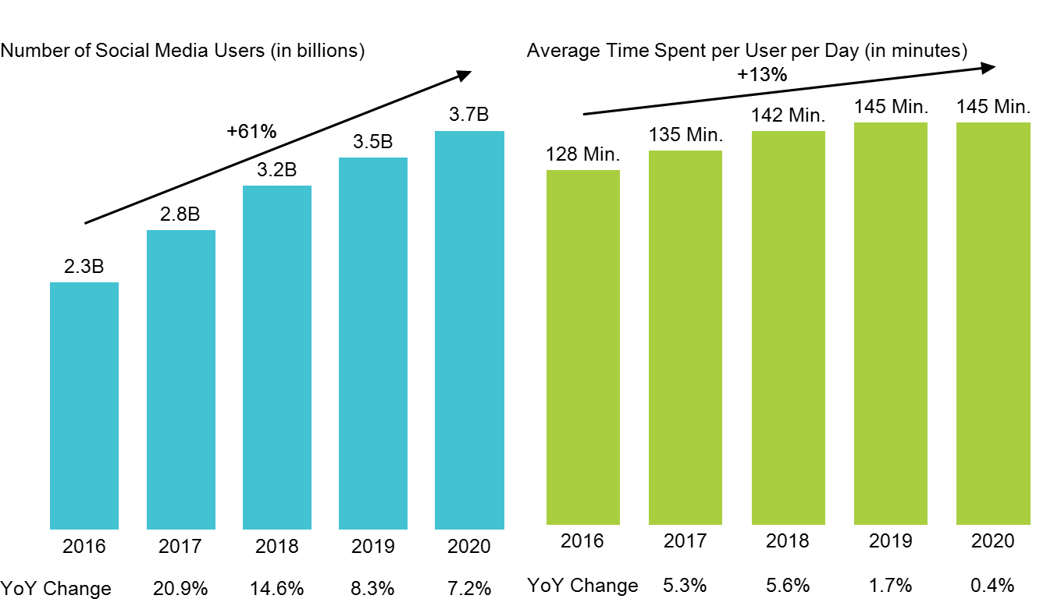
Introduction
As we saw during the pandemic, Twitter has been widely used to distribute important information and recent news.
Many organisations and people have tried to exploit Twitter’s reach by propagating unconfirmed and fake news.
There needs to be a efficient way to predict whether a news is fake or real and we plan to explore different text classification models to find the one with the best performance..
We will be comparing Logistic Regression, RNN, LSTM, and GloVe+LSTM

Slide 3
Dataset
Dataset consists of 2 CSV files - Fake.csv and True.csv
4 columns in each file - title, text, subject, date
Fake.csv has 17903 unique titles out of which:
39% are news-related
29% are politics-related
32% are labeled as others
True.csv has 20826 unique titles out of which:
47% are world news-related
53% are politics-related

Slide 4
Data Pre-Processing
We combined the true news dataset with the fake news dataset and set the target variable to 1 for true news and 0 for fake news. Data preprocessing is an important step in any NLP task. To obtain cleaned data, the raw data collected through various means is passed through a pipeline of NLP preprocessing. This pipeline includes the following NLP tasks:
● Removing newlines and tabs/whitespaces/links/special characters/ stopwords ● Strip HTML tags ● Reducing repeated characters and punctuations ● Expand contractions ● Correcting misspelled words ● Lemmatization/stemming

Slide 5
Exploratory Data Analysis

Slide 6
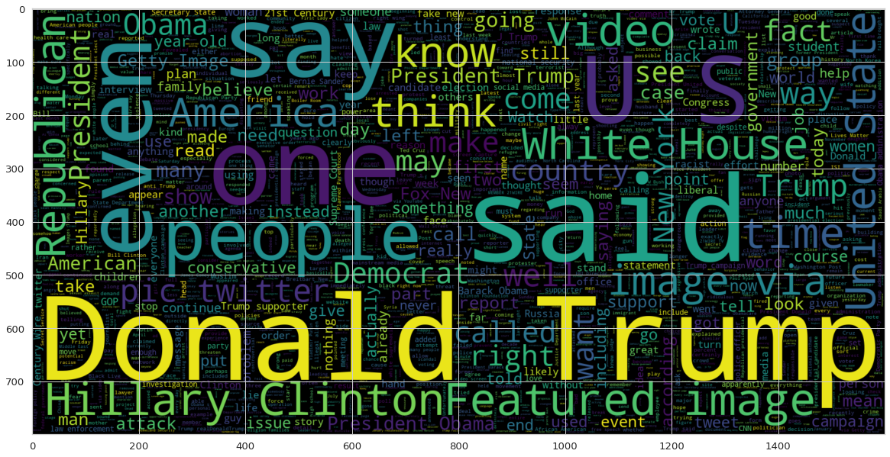
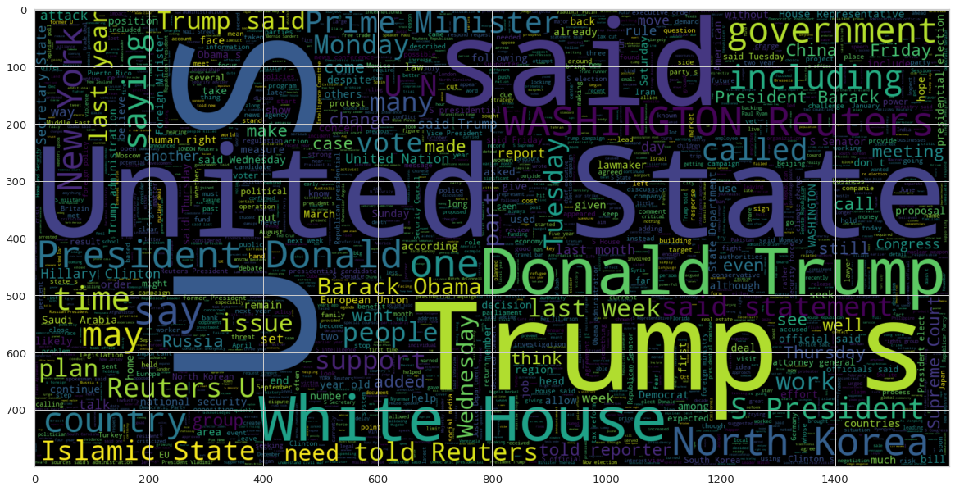
Word clouds
Real articles word cloud
Fake articles word cloud

Slide 7
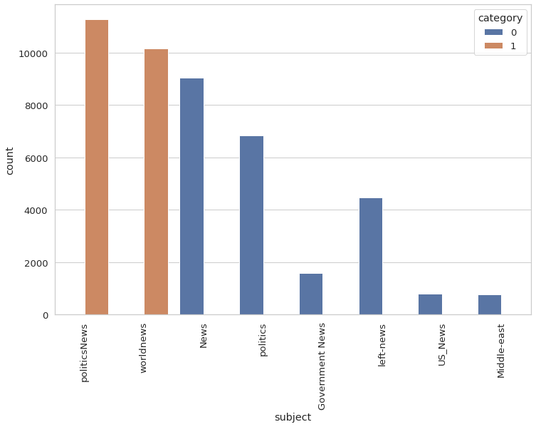
Categories of articles

Slide 8
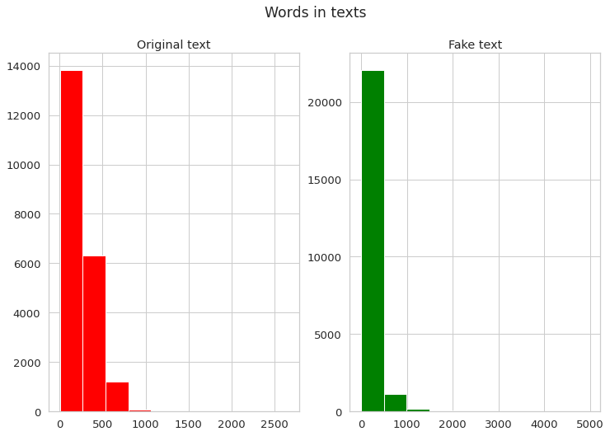
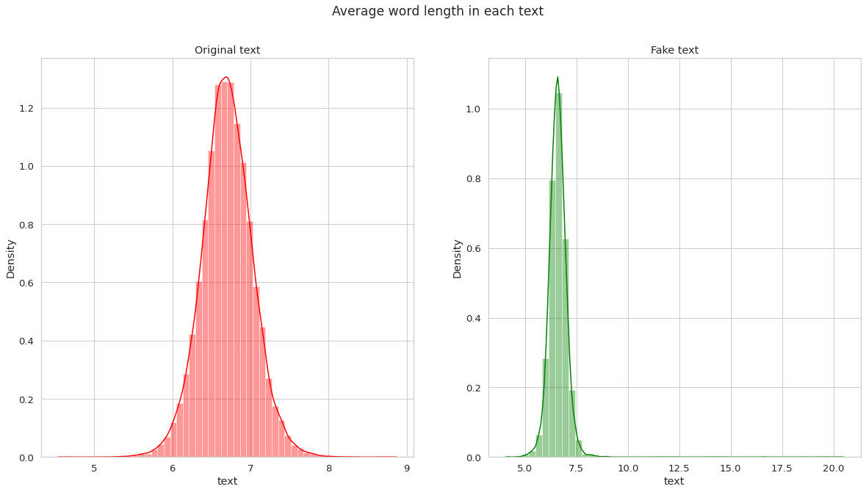
Statistical Analysis
Number of words in the texts
Average length of words in the texts

Slide 9
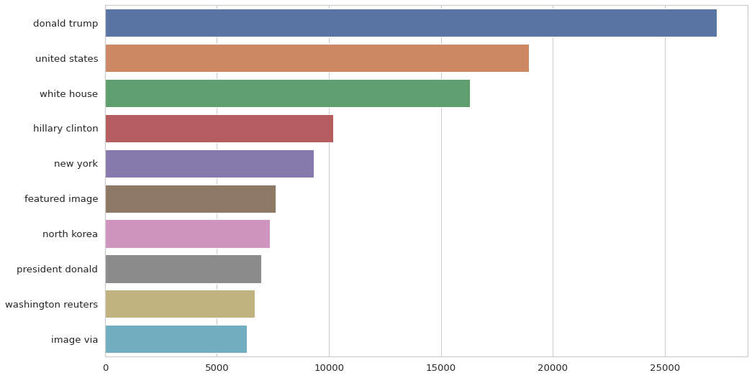
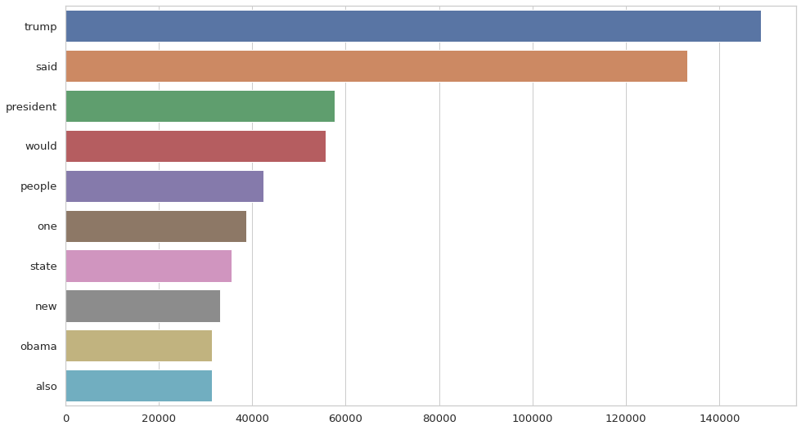
N-grams Analysis
Unigrams
Bigrams

Slide 10
Countvectorizer + Logistic Regression
Logistic regression is a statistical analysis method to predict a binary outcome, such as real or fake, based on prior observations of a data set
It predicts a dependent data variable (real or fake) by analysing the relationship between one or more existing independent variables (contents/titles/subject/date)
In this approach, the Count Vectorizer was used to convert text data into a token count matrix.
The dataset was randomly divided into 80:20 train and test sets.
Three different predictions are made, each with a different component, and their outcomes are analysed using the accuracy and confusion matrices.
We made predictions based solely on the title, using only the contents of the articles, and finally, based on the combination of the article titles and content.

Slide 11
Word Embeddings
Word embeddings are vectorized representations of text that have similar representations for words with similar meanings
Before feeding the text to a machine learning model, all tokens in the text must be converted to word embeddings. We have primarily focused on GloVe and Word2Vec embeddings.
GloVe generates vector representations by using the similarity score between two tokens as an invariant. GloVe generates word vectors using both global and local statistical data.
Word2Vec can make good guesses about a word's meaning based on its occurrences in the text given a large enough dataset. Word associations with other words in the corpus are produced by these estimates.

Slide 12
Recurrent Neural Network (RNN)
Recurrent Neural Networks are a type of artificial neural network that is commonly used for sequence data such as natural language or time series data.
RNNs are Neural Networks in which the previous layer output is also supplied as input to the next layer, assisting the network in better understanding the relationships.
In this approach, the words are sequenced to create the word vectors.
The data is then randomly split into 80:20 train:test ratio.
The model consists of an embedding layer, two bidirectional LSTM layers, one dropout layer, and two dense layers, utilising the ReLu activation function.
This model yielded impressive results.

Slide 13
Word2Vec + Long Short-Term Memory (LSTM)
Long short-term memory (LSTM) networks are commonly used to replace RNN networks to avoid problems such as vanishing and exploding gradient descent.
We compared the prediction results of manually created word vectors versus pre-trained vectors trained on a subset of the Google News dataset for this approach (about 100 billion words).
Three million words and phrases are represented by 300-dimensional vectors in the model.
The LSTM model for the first part, where the word vectors are created using gensim, consists of an embedding layer, an LSTM layer, and the final dense layer.
Finally, the model that used the pre-trained vectors had one layer of embedding, convolutional, max-pooling, LSTM, and final density each.

Slide 14
GloVe + Long Short-Term Memory (LSTM)
In this approach, the GloVe embedding is employed
The data is shredded off of the title, subjects and dates.
The learning rate for this model is intelligently reduced when the model stops learning anything new.
Here, the dataset is randomly split and passed through an LSTM model that consists of an embedding layer, two each of LSTM and dense layers, and uses the ReLu and Sigmoid activation functions.
This model, with the inclusion of the GloVe embedding performs exceptionally well.

Slide 15
Comparing Results
Model | Accuracy
CountVectorizer + Logistic Regression with only titles | 94.75%
CountVectorizer + Logistic Regression with only contents | 99.54%
CountVectorizer + Logistic Regression with both titles & contents | 99.67%
RNN | 98.89%
Word2Vec + LSTM with manual vectors | 97.49%
Word2Vec + LSTM with pre-trained vectors | 97.98%
GloVe + LSTM | 99.74%

Slide 16
Conclusion
The project aimed to classify fake news from real news related to various categories.
A fake and real news dataset from Kaggle was used to train and test the models.
Various supervised machine learning models such as Logistic Regression, RNN, and LSTM were trained, in inclusion with word-embedding techniques such as CountVectorizer, GloVe, and Word2Vec, to compare the performances.
The GloVe + LSTM model out-performed other models.
Although the GloVe + LSTM model outcasted other models, it took a much longer time to train than the rest of the models, but a huge difference in accuracy was not seen.
The logistic regression model trained the quickest, taking almost half the time as the RNN and Word2Vec + LSTM networks, and one fourth the time of a GloVe + LSTM network.

Slide 17
Future Work
Improve the accuracy of the models even further
Convolutional Neural Networks can be used in conjunction with other sequential models
Transformers, BERTs, and GPTs are attention networks that can be fine-tuned to classify fake news
Consider domain-specific approaches to data modelling, such as NewsBERT.
Use extended datasets, which may include more than one dataset.

Slide 18
Thank You!

